Slide 1
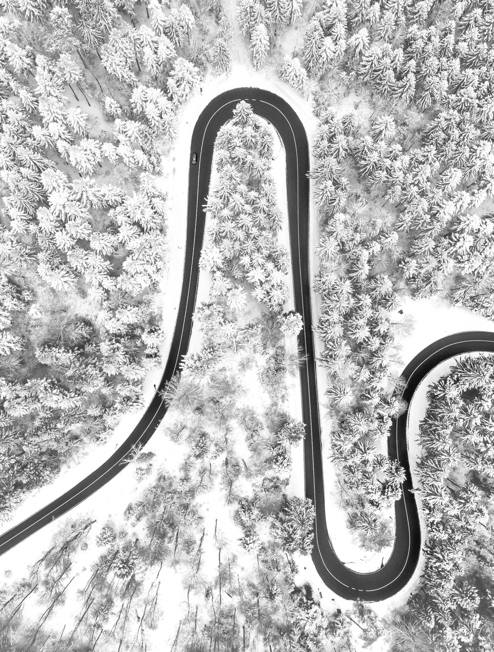
Update 2 Road and field boundary detection in satellite imagery
Group 15
Harshavardhan Reddy Mallannagari
Preethi Vahitha Sankineni
Sasidhar Yalamanchili

Slide 2

Topics
Dataset - Ground Truth
Preprocessing
Methodology
Results
Timeline – Work Done
​Timeline – Future work

Slide 3
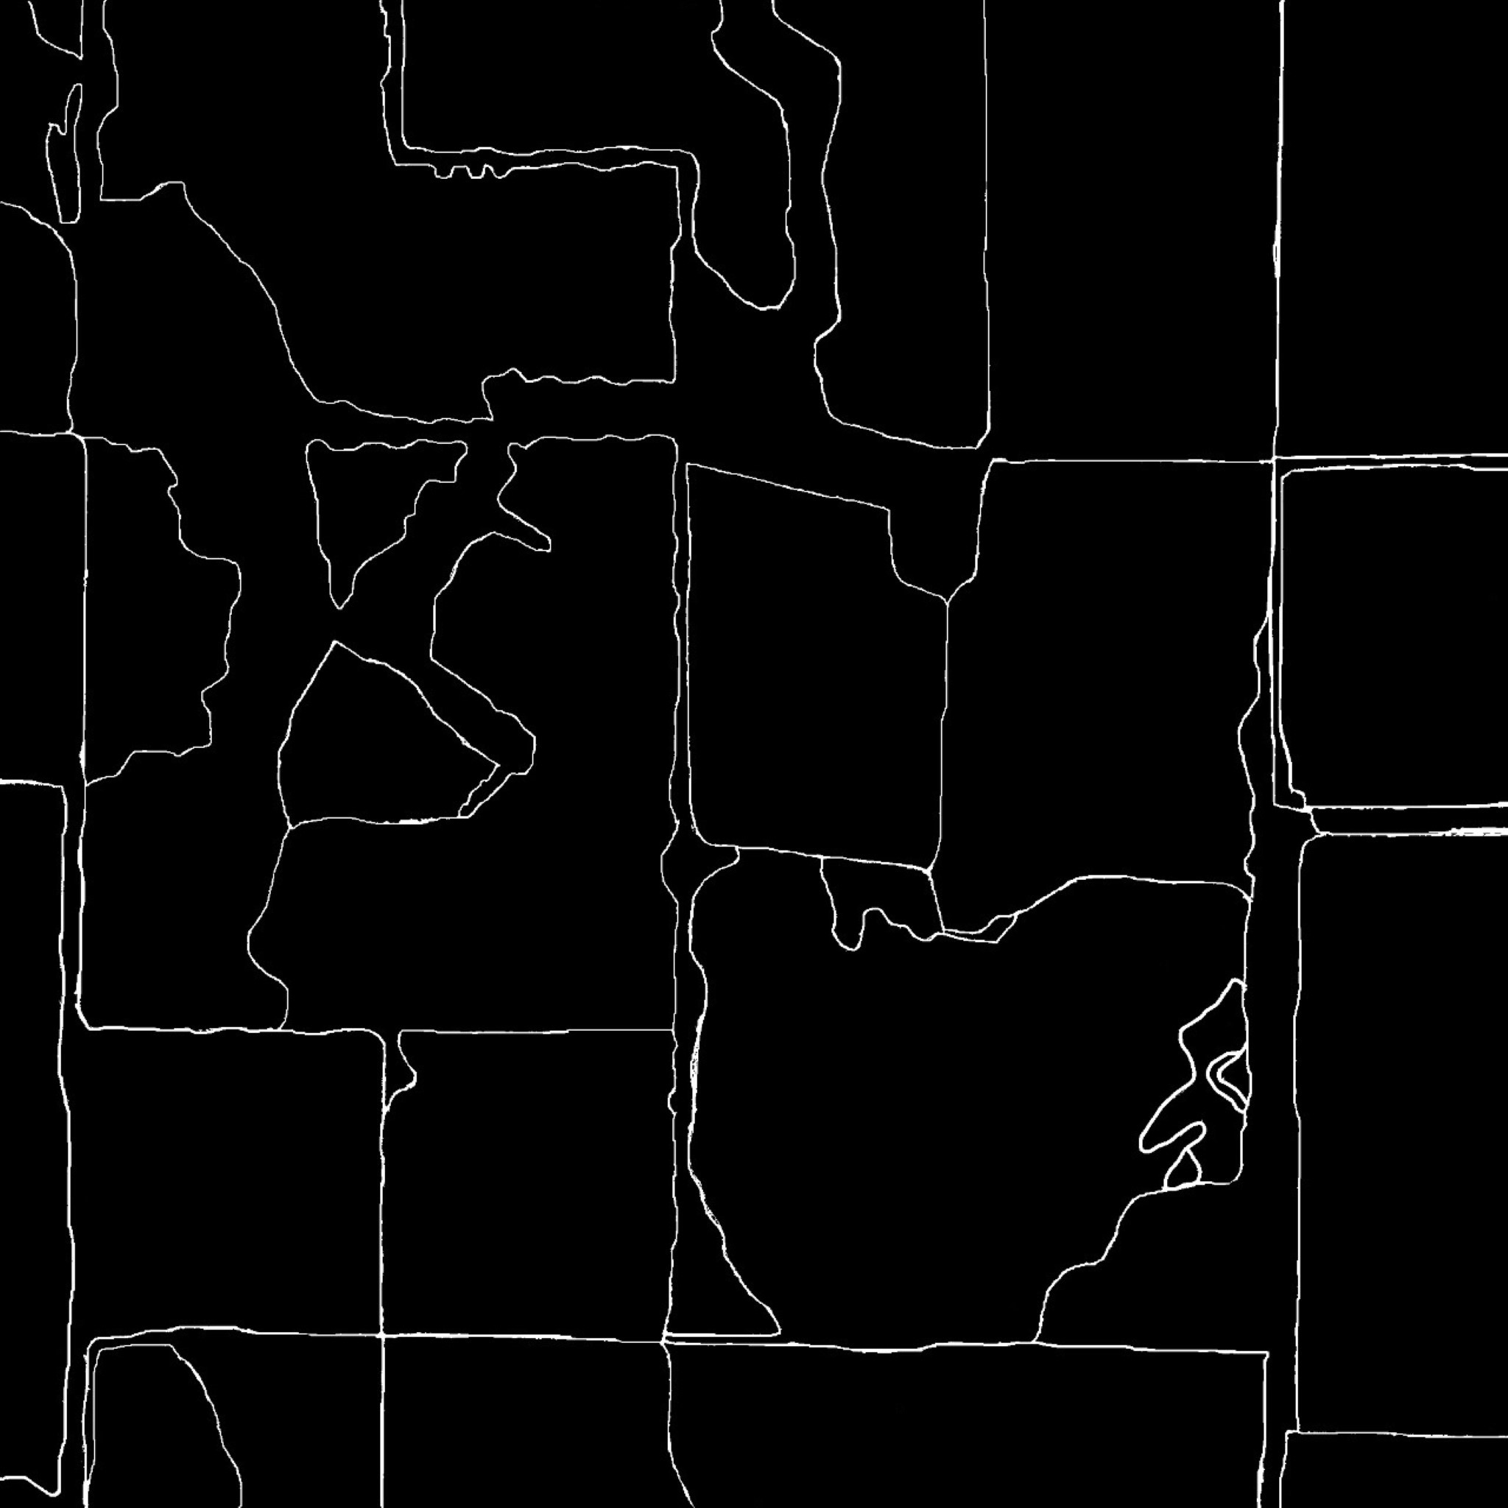
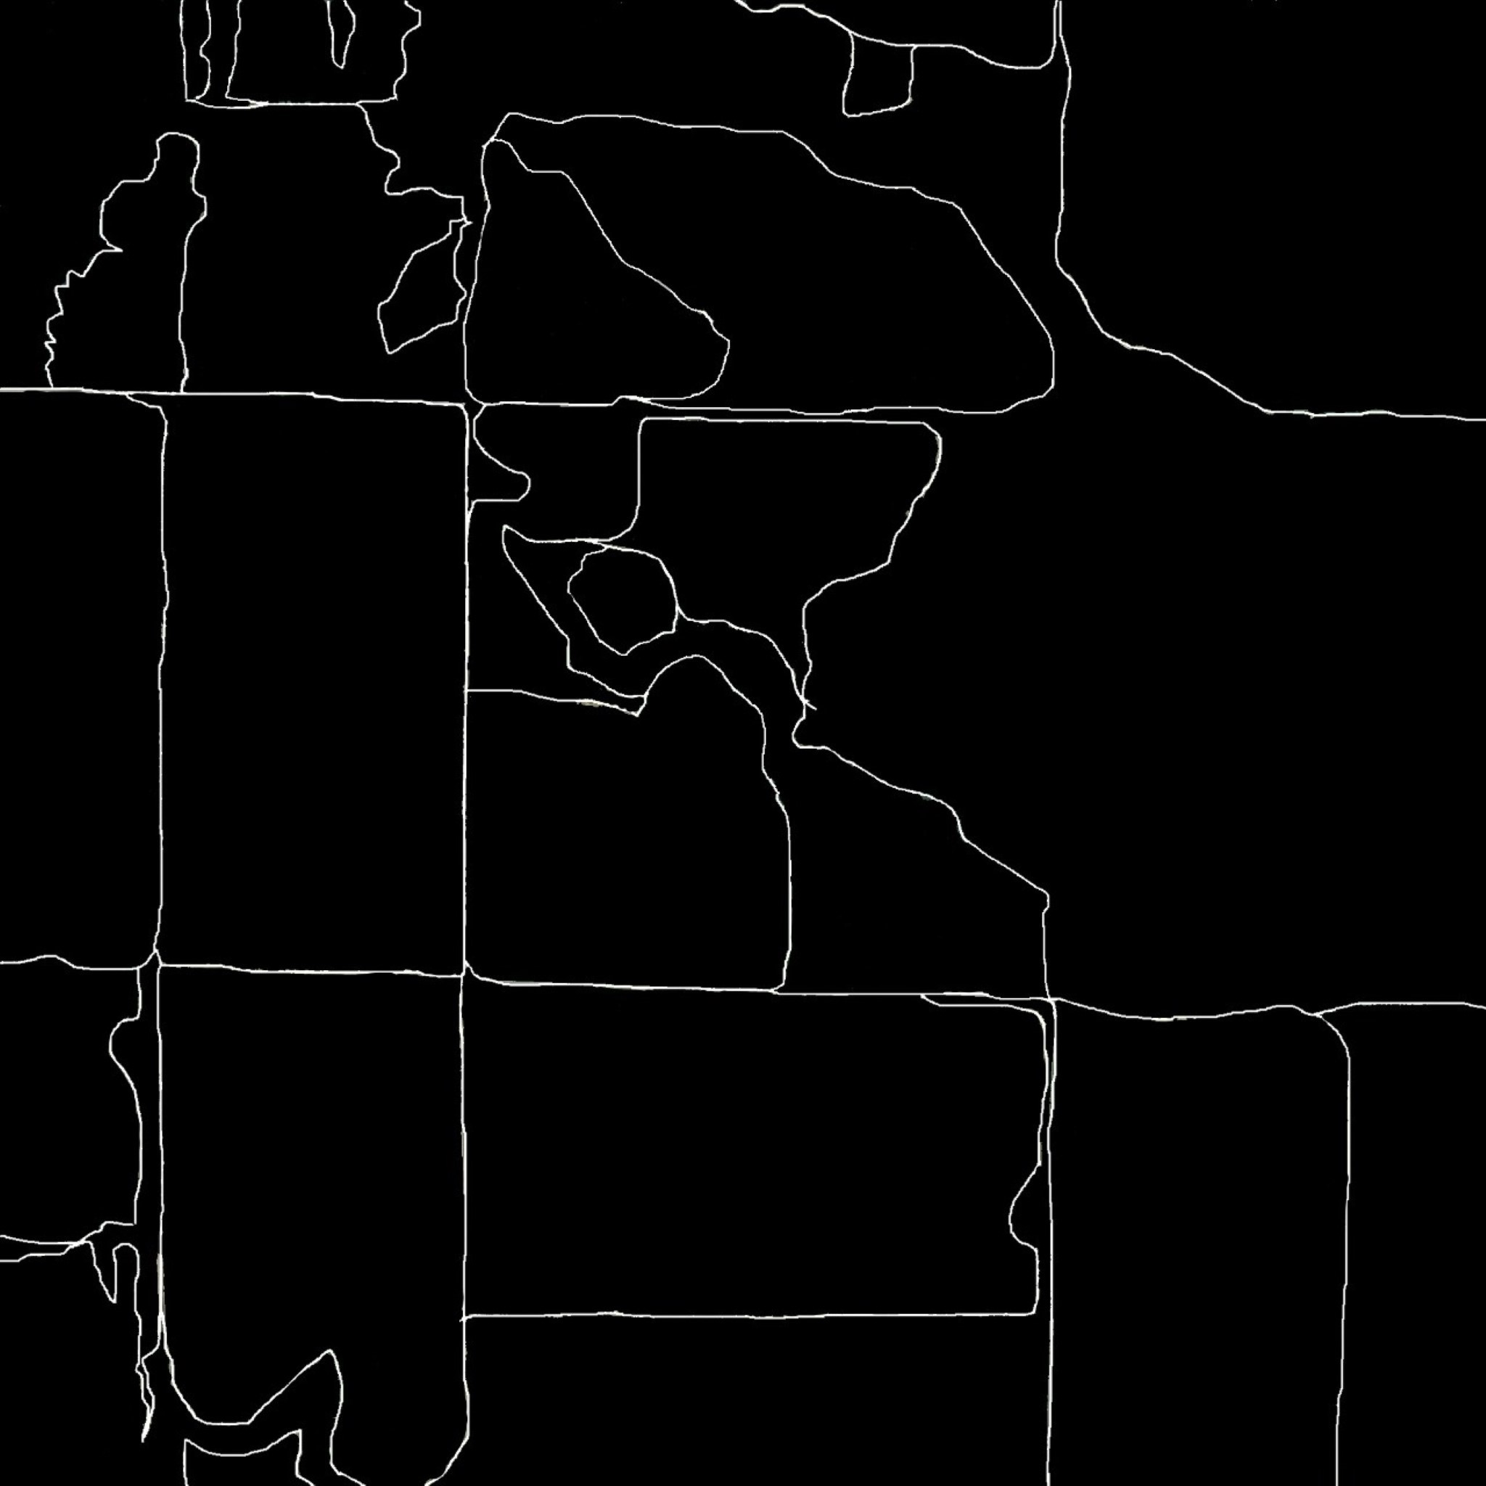
Dataset – Ground Truth Source Apeer.com
L96a
field
L88a
L88b

Slide 4
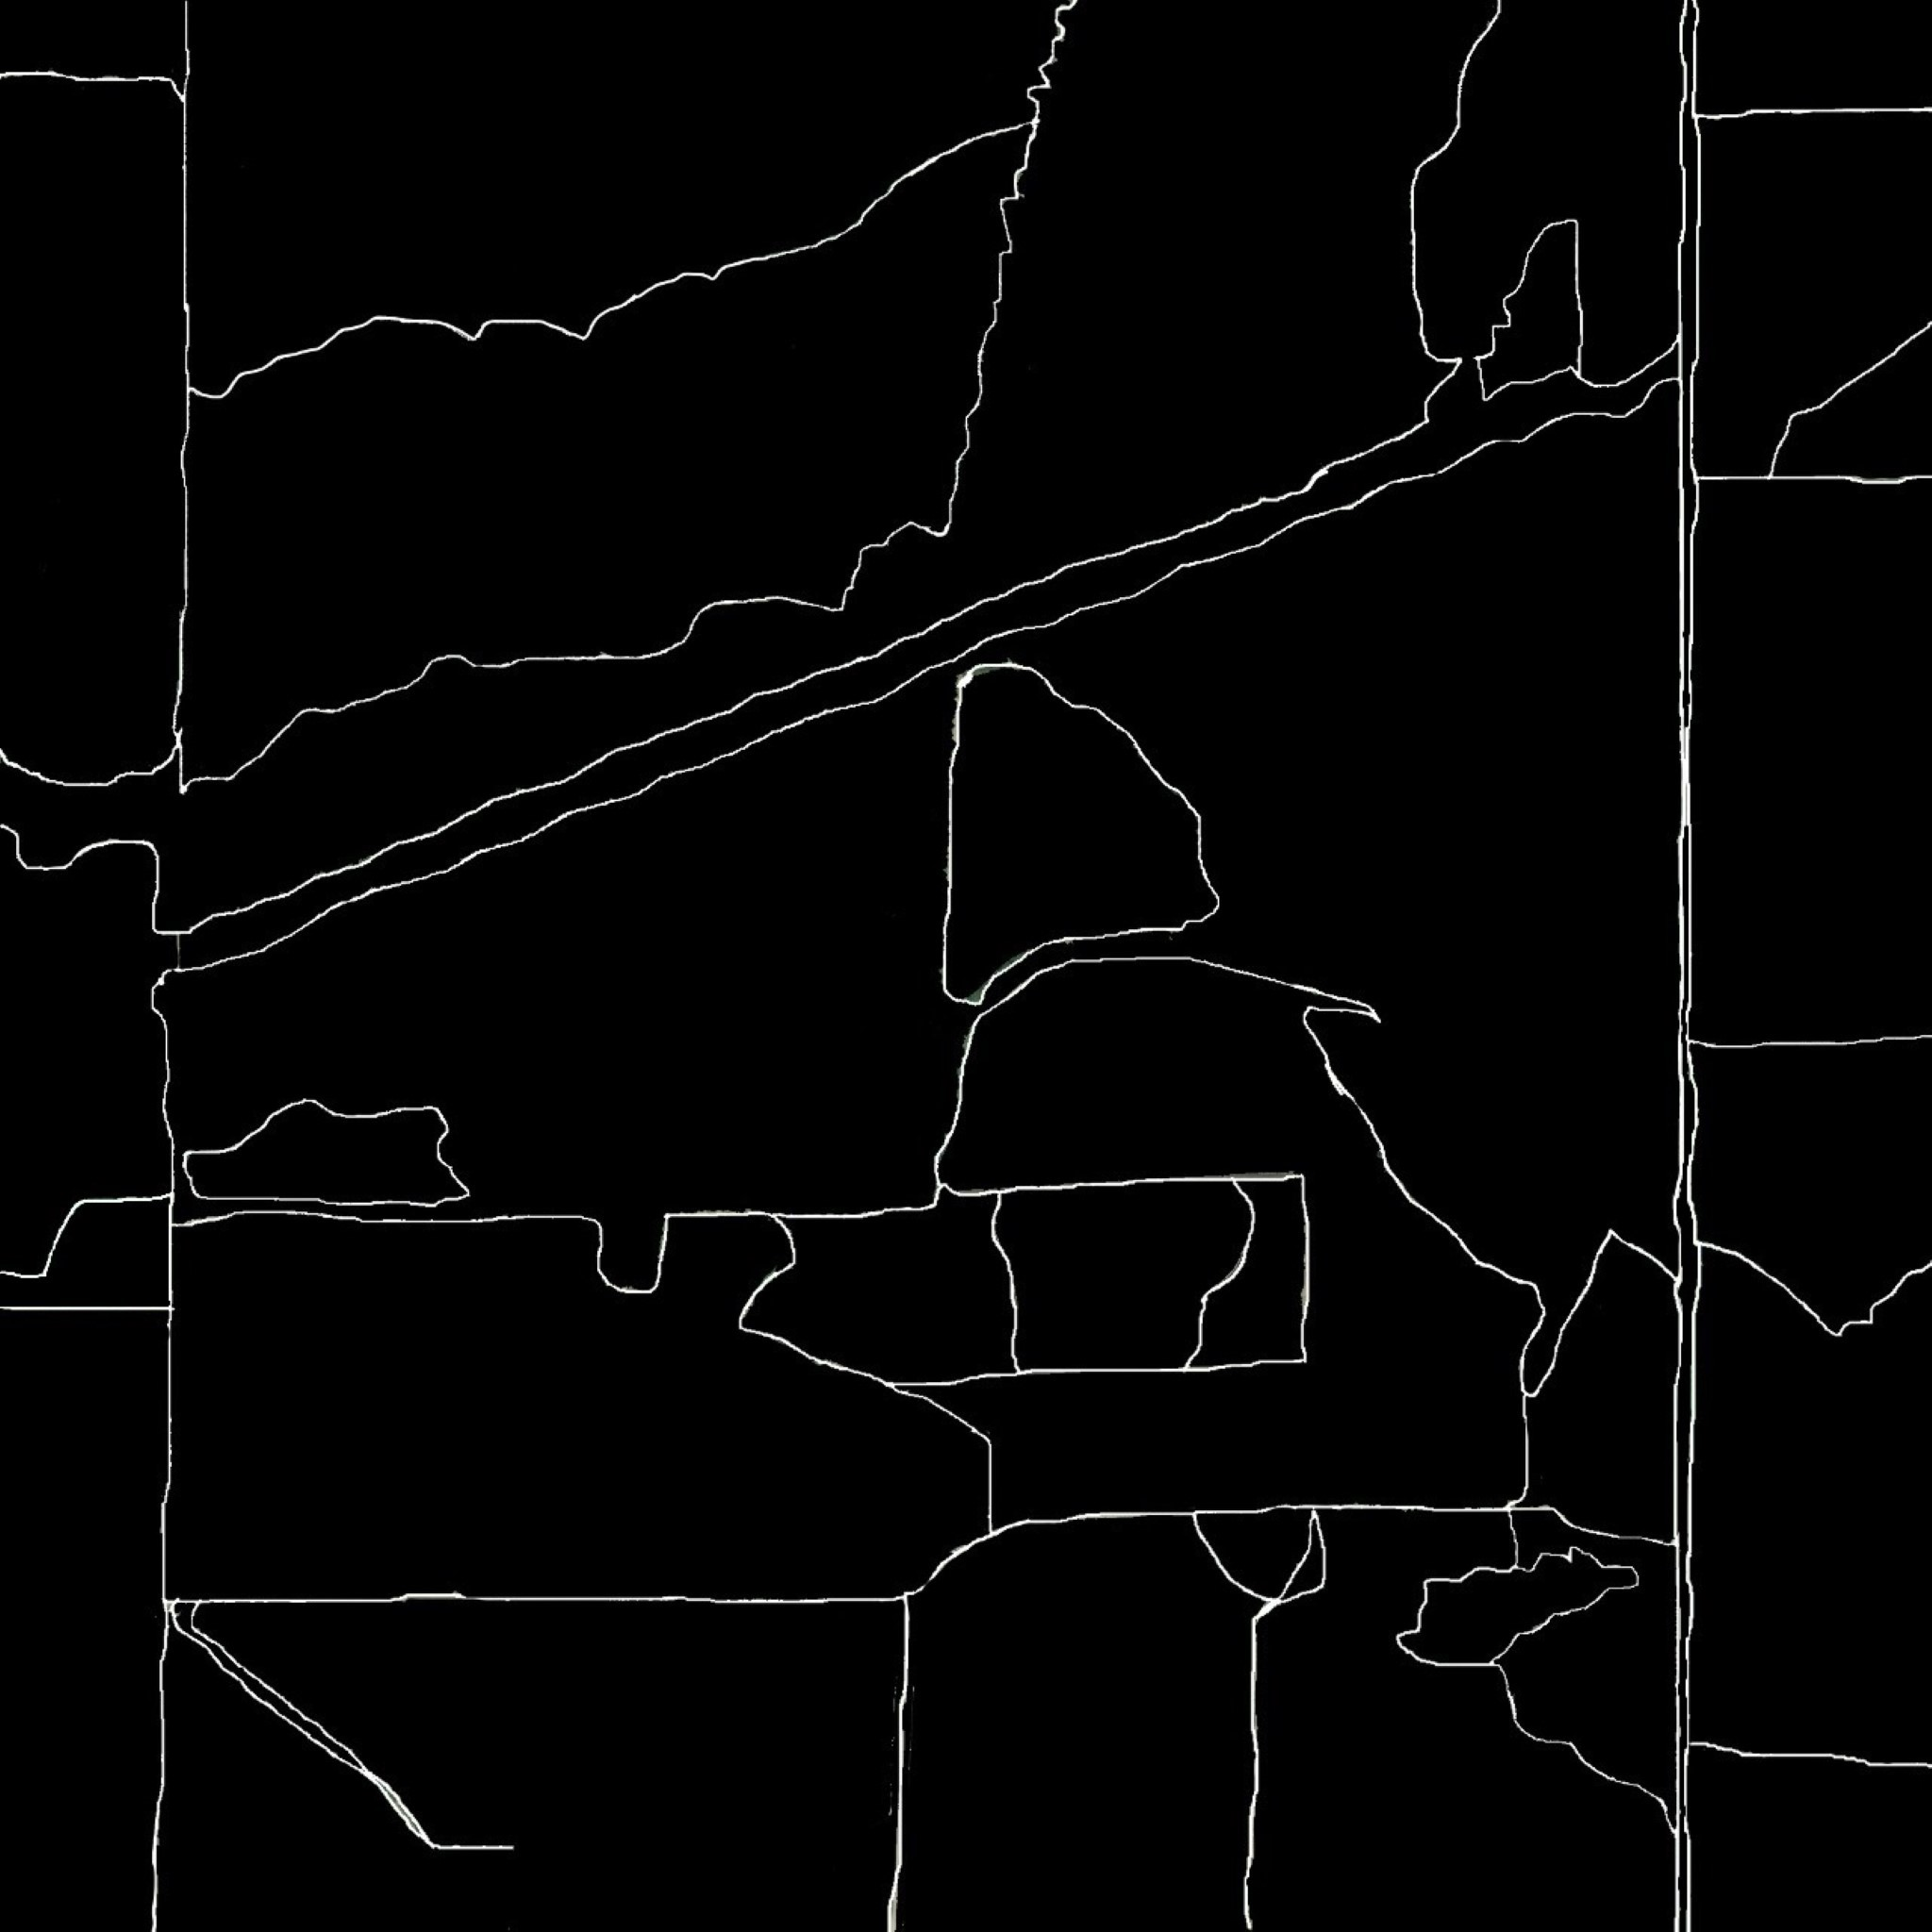
Dataset – Ground Truth
W107a
L97a
L96b
L97b

Slide 5
Preprocessing
Applying preprocessing techniques like
Dog Filter
Histogram equalization
Histogram stretching
Gaussian Smoothing

Slide 6
Methodology
Methods Implemented
Completed Harris Corner Detection
Applied DoG filter
Simple Hough transform
Hough Transform with image splitting
Hough Transform For detecting soft Curves

Slide 7
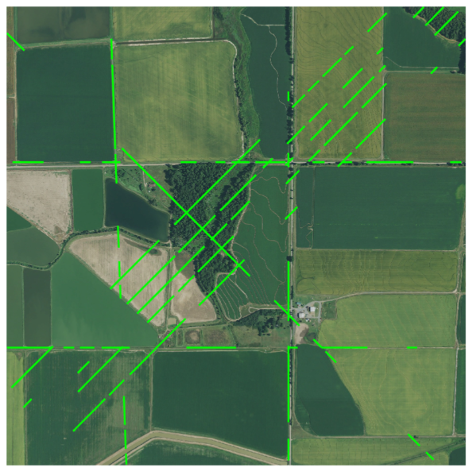
Issues While Developing
Virtual Lines
Virtual Lines across images

Slide 8
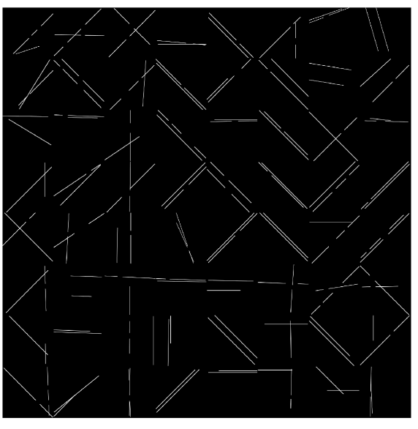
Method to resolve
Divided the image to 64 equal parts and performed hough transform on each part separately.
Next Problem
Unable to detect curves- Only able to detect straight lines
Hough Lines Straight Only

Slide 9
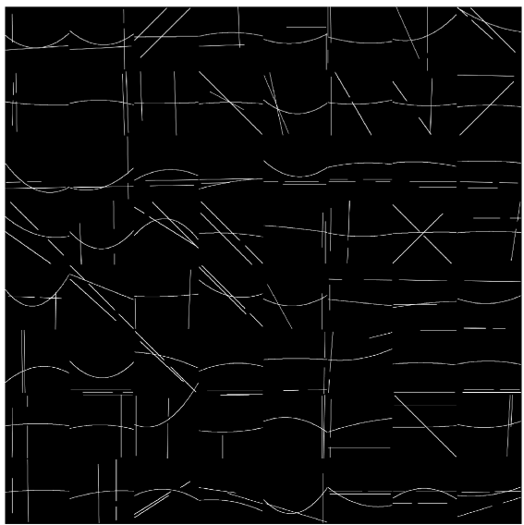
Implemented Hough Transform for curves
Able to detect soft curves.
Problems
Able to detect only soft curves
Unable to detect curves correctly
Soft Curves Only Not Matching the original Curves

Slide 10
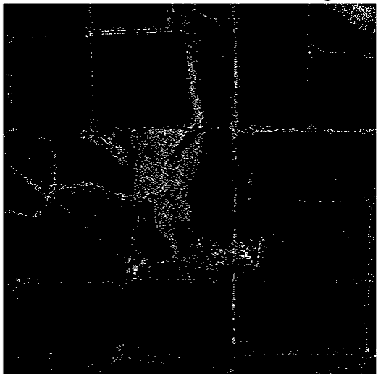
Fail - Harris
Image is not clear and Detected the edges but
many issues when it comes to forests.
Detecting complete forest. Increasing Filter size causes Road Detection Less
accurate
SSIM Accuracy : 49.04 Fail Case
Image after performing Harris Corner Detection

Slide 11
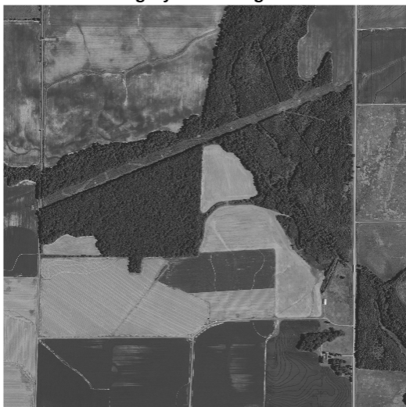
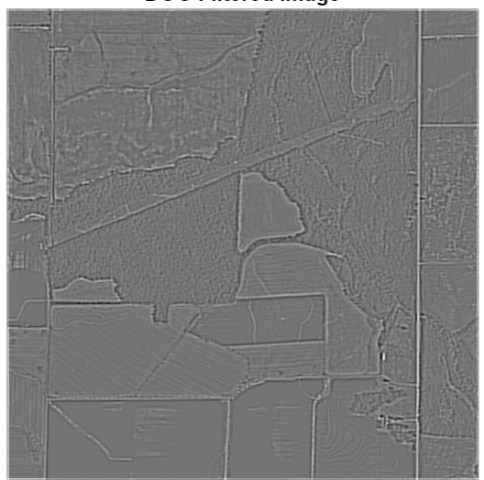
DoG Filter
Gray Scale Image
After DoG Filter

Slide 12
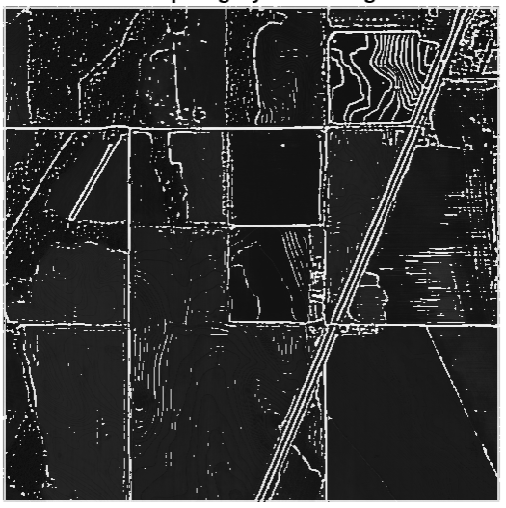
Convoluted image after DoG
Ground Truth
Generated Image

Slide 13
Methods and Results
Image | Method/Filter | SSIM Accuracy/ Accuracy
Field | DOG | 76.8 / 80.70
L88a | DOG | 69.10 / 85.5
L88b | DOG | 64.82 / 83.3
L96a | DOG | 71.84 / 80.58
L96b | DOG | 77.94 / 80.32
L97a | DOG | 72.50 / 79.71
L97b | DOG | 61.54 / 82.50
W107a | DOG | 82.61 / 83.61
W107b | DOG | 70.471 / 88.75

Slide 14
Methods and Results
Image | Method/Filter | SSIM Accuracy/ Accuracy
Field | Hough Transform Splitting | 80.54
L88a | Hough Transform Splitting | 77.97
L88b | Hough Transform Splitting | 76.58
L96a | Hough Transform Splitting | 80.19
L96b | Hough Transform Splitting | 85.47
L97a | Hough Transform Splitting | 85.96
L97b | Hough Transform Splitting | 73.09
W107a | Hough Transform Splitting | 86.96
W107b | Hough Transform Splitting | 83.95

Slide 15
TimeLine – Work Done
Method | Start Date | End Date
Canny Edge | October 1 | October 15
Sobel Edge | October 1 | October 15
Histogram Equalization | October 1 | October 15
Histogram stretching | October 15 | October 15
Harris Corner Detection | October 16 | October 30
Hough Transform | October 16 | October 30
Hough Transform for Curves | November 1 | November 12
DoG Filter | November 1 | November 12

Slide 16
TimeLine Future Work
Methods | Start Date | End Date
Implementing Harris + Hough | November 16 | November 30
Gabor Filter(if Time permits) | November 16 | November 30
Hough + DoG | November 16 | November 30
Full Report | November 16 | November 30
Presentation Including All | November 16 | November 30

Slide 17
References
https://stackoverflow.com/questions/39123267/how-to-detect-smooth-curves-in-matlab
Apeer.com
Matlab Documentation

Slide 18

Thank You

